Slide 1
MTAS Automation Testing
Anoosha, Cathy

Slide 2
TOPICS
API TEST LAYER
API TEST AUTOMATION FRAMEWORKS
HOW TO CHOOSE API TEST FRAMEWORK
CONCLUSION

Slide 3
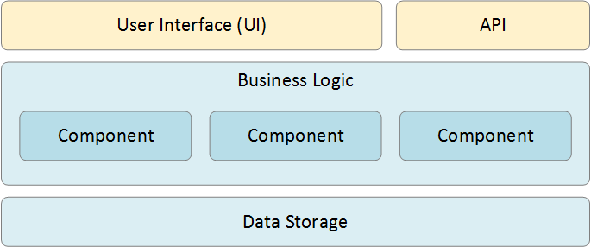
API TEST LAYER
API testing involves testing the application programming interfaces (APIs) directly and as part of integration testing to determine if they meet expectations for functionality, reliability, performance, and security
API testing is performed at the message layer

Slide 4
TEST AUTOMATION FRAMEWORKS
These are few different API Testing tools which we were looking into.
Zerocode
Citrus
Rest Assured
JMeter

Slide 5
ZERO CODE
Java based framework for interface testing. It supports Rest, Soap and any http based api testing.
Zerocode makes it easy to create and maintain automated tests with absolute minimum overhead for REST,SOAP, Kafka, DB services and more.
In this Declarative style we attempt to minimize or eliminate side effects by describing what the test must accomplish in terms of the business functionality, rather than describe how to accomplish it via programming or coding.
We can easily validate API using Zerocode using YAML and run it simply by pointing to the above JSON/YAML file from a JUnit @Test method.
url: api/v1/customers/123
method: GET
request:
headers:
Content-Type: application/json
retry:
max: 3
delay: 1000
verify:
status: 200
headers:
Content-Type:
- application/json; charset=utf-8
body:
id: 123
type: Premium Visa
addresses:
type: Billing
line1: 10 Random St
verifyMode: LINIENT

Slide 6
REST ASSURE
REST Assured allows to write the tests using Gherkin language (Given-When-Then syntax) so even if we need some Java coding skills, tests are fairly human readable.
REST Assured can be used to test XML as well as JSON based web services. REST Assured can be integrated with JUnit and TestNG frameworks for writing test cases for our application.
REST Assured supports POST, GET, PUT, DELETE, OPTIONS, PATCH, and HEAD requests and can be used to validate and verify the response of these requests.
DISADVANTAGES OF REST ASSURED:-
Does not support SOAP APIs explicitly.
Less community support
Requires good Java programming knowledge

Slide 7
JMETER
JMeter to analyze and measure the performance of web application or a variety of services. Performance Testing means testing a web application against heavy load, multiple and concurrent user traffic. ... Nowadays, it is used for a functional test, database server test etc
JMeter has the ability to extract data from popular response formats like HTML, JSON, XML or any textual format.
DISADVANTAGES OF JMETER:-
JMeter can simulate heavy load and visualize the test report. This may consume lots of memory and can lead out of memory under heavy load.
It has limited support for processing JavaScript or Ajax, this may affect the accuracy of simulation.

Slide 8
CITRUS
Gives a complete test automation tool for integration testing of enterprise applications.
Regression testing and continuous integration is very easy using Citrus.
With powerful validation capabilities for XML, CSV or JSON, Citrus is designed to provide fully automated integration tests for end-to-end use cases.

Slide 9
HOW TO CHOOSE FRAMEWORK
These are some factors that we have to consider while choosing the framework.
User requirements
Licensing and support costs
Good test reports
CI support
Level of programming skills required

Slide 10
CONCLUSION
Considering our project requirements, We have concluded that Zerocode and Citrus are the suitable frameworks for the test automation.
Given the disadvantages of JMeter an

